Slide 1


Creating a Supportive School Environment:
5 Key Strategies to Sustain and
Support Your Staff
September 19, 2024
Presented by
Moderated by
Laurie VanderPloeg
Associate Executive Director, CEC
George Dayton
Director of Strategic Partnerships, eLuma

Slide 2

Laurie VanderPloeg is a seasoned expert in special education and staffing retention, with a career spanning 38 years. She has held prominent positions, including Director of the Office of Special Education Programs (OSEP) and Executive Director of the Council for Exceptional Children (CEC).
Currently, she works with OPTIMISE, focusing on enhancing Michigan’s special education workforce. Inspired by her mother’s dedication as an early instructional support pioneer, Laurie pursued a Bachelor of Science degree at Grand Valley State University and later a master’s degree in special education administration. Her extensive experience includes teaching, consulting, and leadership roles in various educational institutions.
Laurie’s commitment to high-quality education for students with disabilities and her expertise in developing strong leadership competencies make her a valuable asset in the field.

Slide 3

Agenda
Introduction
Presentation
Discussion
1:00 pm EST (5 minutes)
1:05 pm EST (45 minutes)
1:50 pm EST (10 minutes)

Slide 4
Educator Shortage Definition
U.S. Department of Education added a definition of “educator,” which includes early childhood educators, teachers, principals and other school leaders, specialized instructional support personnel (e.g., school psychologists, counselors, school social workers), paraeducators, and faculty
CEC is aligned with this definition.

Slide 5
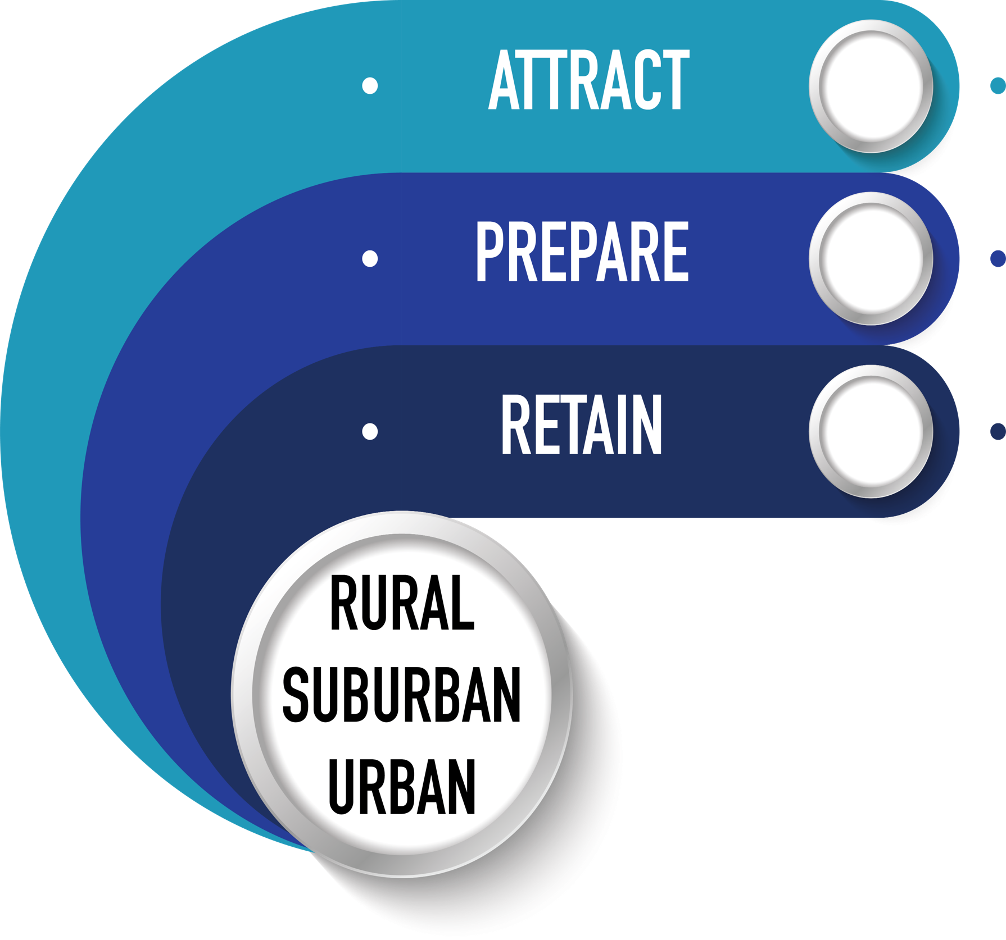
Equal Importance Across All Areas

Slide 6

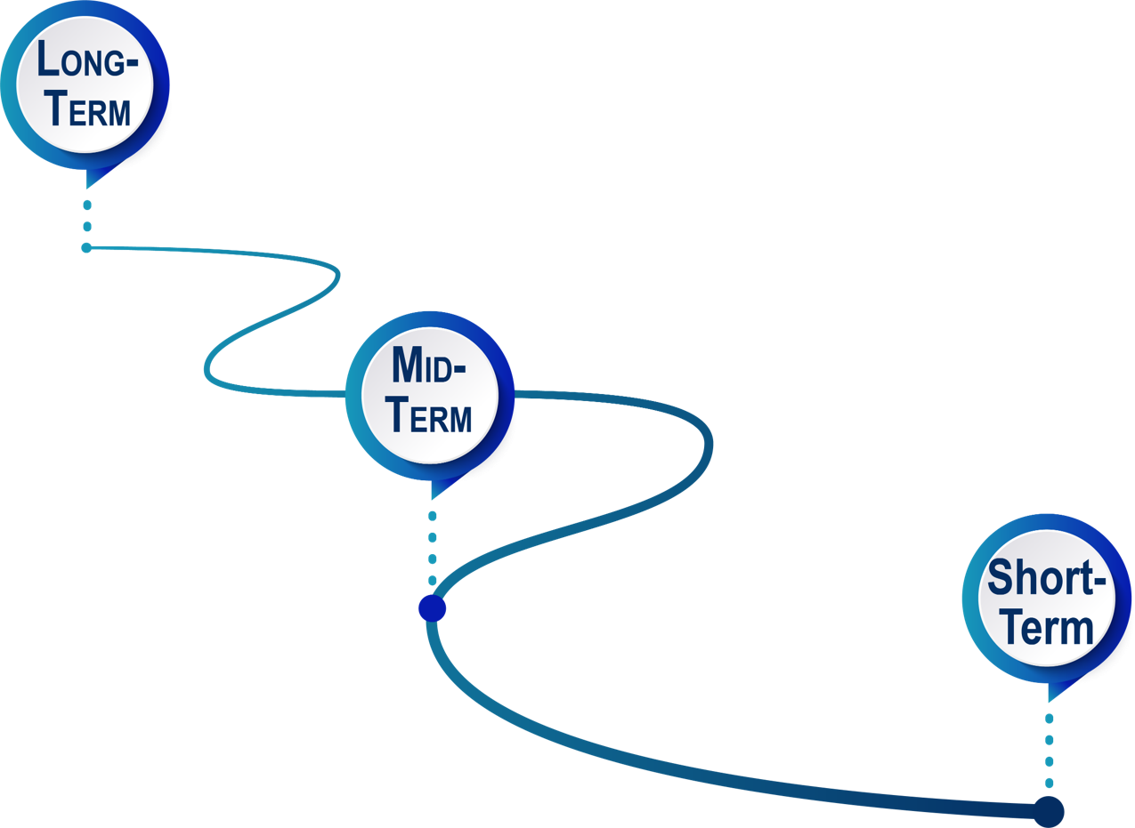
Identify Retention Strategies
All are necessary to create systematic and sustainable change!
No Band-Aids (Or limit them)!

Slide 7
U.S. Department of Education Report.
7.7 million (roughly 15%) of individuals with disabilities were served under IDEA during the 2023-2024 school year. Up from 13% a decade earlier.
Increase in special education identification in specific categories. Requires more qualified staff!
552,677 paraeducators serving children with disabilities and only 487,299 special education teachers (U.S. Department of Education 2024)

Slide 8
Educator Shortage Impact
Nearly 9 in 10 schools struggle to hire qualified educators
86% of districts had trouble filling their open positions for the 2023-24 school year.
Around 70% of educators say their school is understaffed, leading to a heavier workload.
Nearly 60% of schools have trouble finding substitute teachers.
In K-12 education, 39% of teachers say they feel burned out “very often” or “always.”
More than three-quarters of teachers find their jobs stressful on a regular basis.

Slide 9
Educator Shortage Impact
Without significant intervention, by the 2025-2026 school year, there is projected to be a shortfall of roughly 200,000 public school teachers.
Based on Bureau of Labor Statistics projections, between 2020 and 2030, 37,600 new special education teachers are required to keep up with demand.
Up to 50% of new teachers leave the profession in the first few years.
Minimal preparation are more likely to leave than their prepared peers.

Slide 10
Why They Leave
Attrition: special educators leave the field of education for non-education work (career changers, retirement, work stress and dissatisfaction, etc.)
Transfers: going from special education to general education positions
Migration: Move to another special education position

Slide 11
The Impact
Leaving the field due to not having time to assess, design and deliver specially designed instruction
Inclusive practices, co-teaching, supported instruction, assessments and services in the general education setting requires more emphasis on workload responsibilities
Intended to adapt to the changing responsibilities of special educators
Increase in caseloads equals an increase in meeting times and paperwork demands
Large caseloads contribute to the high attrition rate in special education
Larger caseloads are perceived to diminish student outcomes on IEPs and negatively impacted the ability to meet individuals with disabilities needs

Slide 12
Five Retention Strategies, Plus One
Induction and Mentoring
Professional Learning Opportunities
Workload/Caseload
Building Leaders- Inclusive and Instructional Leadership
Elevate the Profession- Change the Perception
Supply and Demand Data

Slide 13

Induction & Mentoring

Slide 14
Induction and Mentoring
Induction is a system of coordinated and aligned supports designed to support new educators with a systematic pathway into the profession.
Mentoring refers to one-on-one support and feedback provided by an experienced professional to new educators.
Strong induction programs that rely on well-trained mentors, provide systematic professional learning opportunities, and introduce new teachers into a collaborative school culture, promote retention in the field and effective teaching, particularly when provided over a 2-year period.

Slide 15
Induction and Mentoring
Promote instructional practice from preservice to in-service for core instruction
Promote evidence-based/high-leverage instructional practices
“A set of practices that are fundamental to support EC–12 student learning, and that can be taught, learned, and implemented by those entering the profession.”

Slide 16
Induction & Mentoring Includes:
Professional development systems established by administrators to provide targeted learning; and mentoring partnerships in subject areas or disciplines
  E.g., early intervention, special education, specialized instructional support personnel.
Targeted feedback and support
Adequate resources
Recommendation: High Leverage Practice Training

Slide 17
Self-Assessment | Yes or No
Mentoring for SE personnel?
PD for beginning SE personnel?
A well-defined role for building leaders?
A well-define role for mentors?
A plan for recruitment and preparation of SE mentors?
Guidelines for matching mentor to mentee?
Training for SE mentors?
A plan for ongoing support for mentors?
A comprehensive plan for evaluation of induction and mentoring program.

Slide 18
Professional Learning

Slide 19
Professional Learning
Special educators who have greater opportunities for professional learning are more satisfied, less likely to leave, report fewer role problems.
Access to high-quality professional learning opportunities:
  Be content focused
  Incorporate active learning
  Support collaboration
  Use models of effective practice
  Provide coaching and expert support
  Offer feedback and reflection
  Be of sustained duration

Slide 20
Professional Learning - High Needs Areas
Tier 1 core instruction for literacy and numeracy
Behavior, mental health, trauma
Data collection, progress monitoring
Specially designed instruction
High Leverage Practices
Culturally Responsive Practices
DON’T FORGET ABOUT SUBSTITUTES!

Slide 21
How to Deliver Professional Development
Asynchronous- high level of engagement & assessment
Synchronous- high level of engagement & assessment
In-person- high level of engagement & assessment
All followed up with a community of practice, technical assistance, resources, coaching and mentoring.
All needed for effective and sustainable implementation!
NO spray and prays!!!

Slide 22
Workload vs Caseload

Slide 23
Workload vs Caseload
Workload-direct and in-direct services (intensified by inclusion, educator shortage, etc.)
Caseload - number of students with Individual Education Programs (IEPs) assigned to teacher or provider.
How do you fairly measure the growing responsibilities and heightened intensity of special education personnel work today?

Slide 24
Workload vs Caseload
Large caseloads has significant impact on student outcomes, can limit service delivery options, collaboration with other professionals, contribute to burnout and stress.
Non-teaching responsibilities (excessive paperwork)

Slide 25
What is Included?
Direct instruction
Planning time and consultation with general ed teachers
Modifications/adaptations of curriculum
Demonstration teaching
Directing the work of paraeducators
Planning with specialized instructional support personnel
Coordination of services
Parent communication

Slide 26
What is Included?
IEP Management
Annual reviews
Progress management
Behavior Intervention plans
Other duties as assigned
https://www.asha.org/slp/schools/workload-calculator/
https://www.aota.org/practice/practice-essentials/payment-policy/caseload-to-workload

Slide 27
Building Leaders- Inclusive and Instructional Leadership

Slide 28
Building Leaders - Inclusive and Instructional Leadership
More likely to stay with supportive administration.
Establish clear SE job responsibilities- role ambiguity.
Encourage a positive and collaborative school climate.
Access to quality curriculum, combined with great PD that supports them in delivering effective instruction.

Slide 29
What They Need: Time
Develop and nurture relationships
Structured collaboration with GE- co-planning, co-teaching
Designing and delivering IEP program/services
Designing and delivering effective instruction
Progress Monitoring
Attending professional development

Slide 30
What They Want
Administrators who understand the complexity of special education, legal requirements
Administrators who provide necessary resources
Administrators who provide clear, and ongoing communication
Administrators who provide a collaborative environment
Administrators who make them feel valued, recognized and who gives them a voice

Slide 31
Elevate the Profession -
Change the Perception

Slide 32
Elevate the Profession- Change the Perception
Critically important for attracting into the profession and retaining current qualified personnel
Current public opinion the profession is associated with low salaries, poor working conditions, and a lack of respect and professional autonomy
Society’s negative view of education is a growing concern - challenge negative media coverage!

Slide 33
Elevate the Profession- Change the Perception
Sharing success stories of personnel and the impact they had in their communities can lead to improved perceptions
Staff recognition in local media, district newsletters, school board meetings, staff meetings, website, etc.
Social media campaign
https://optimise.education/

Slide 34
Bonus: Supply and Demand Data

Slide 35
Supply and Demand Data
Existing data provide an incomplete picture of special education supply and demand.
https://www.k12dive.com/news/senate-bill-teacher-shortage-data/653787/

Slide 36
Assist school districts and their leaders in developing more supportive work environments that attend to issues of workload manageability, collaboration among general and special education teachers, effective curriculum combined with professional development, and administrative support.
Offer professional learning opportunities that engage general and special education teachers in collaboratively designing and implementing instruction.
Collect data on root causes of attrition, working conditions and then design and develop a comprehensive, long-term plan to respond to the causes.
In Summary

Slide 37
Resources

Slide 38

OSEP Retention Strategies
https://osepideasthatwork.org/sites/default/files/R1-EnhancProfessLeadershp-508.pdf
https://osepideasthatwork.org/sites/default/files/R5-InductionMentorship-508.pdf
https://osepideasthatwork.org/sites/default/files/R2-OngoingProfessionLearn-508.pdf
https://osepideasthatwork.org/sites/default/files/R4-TeacherEmpowerment-508.pdf
https://osepideasthatwork.org/sites/default/files/R3-WorkplaceEnvironment-508.pdf

Slide 39
Public Perception
https://osepideasthatwork.org/sites/default/files/A4-Change-Public-Perception-508.pdf

Slide 40
Free Resources
https://exceptionalchildren.org/
https://exceptionalchildren.org/paraeducator
  Paraeducator competencies
  HLP series
  Evaluation Toolkit
https://exceptionalchildren.org/learninglibrary
https://exceptionalchildren.org/topics/high-leverage-practices
12 FREE webinars for members
https://exceptionalchildren.org/fallPDfair
New and early career series

Slide 41
High Leverage Practices (HLPs)
https://exceptionalchildren.org/webinar/early-childhood-recommended-practices-informing-high-leverage-practices-k-3
https://highleveragepractices.org/hlp-leadership-guides
https://highleveragepractices.org/hlp-faculty-guides

Slide 42


Questions?

Slide 43


Next Webinar
A New Practitioner’s Guide to Teletherapy: An Introduction to Teletherapy
Wednesday, October 9 4:00 pm ET

