Slide 1

12 Big Ideas about MTSS
John O’Connor
greatinstruction@bellsouth.net
678.243.8957

Slide 2
A Little about Me
Served in public education for almost 30 years
  Special Education Teacher
  Georgia Department of Education
  Assistant Director
  Executive Director
  Assistant Superintendent
  Director
  Co-Chair of Georgia Dyslexia Collaborative
  Retired!!!

Slide 3



Thank You!!!
Thank You!!!
Thank You!!!

Slide 4
In your handout, you have Scratch Paper.
You will use it today for several activities to jot your ideas.
Our first activity…

Slide 5

You receive an email from your superintendent…

Slide 6
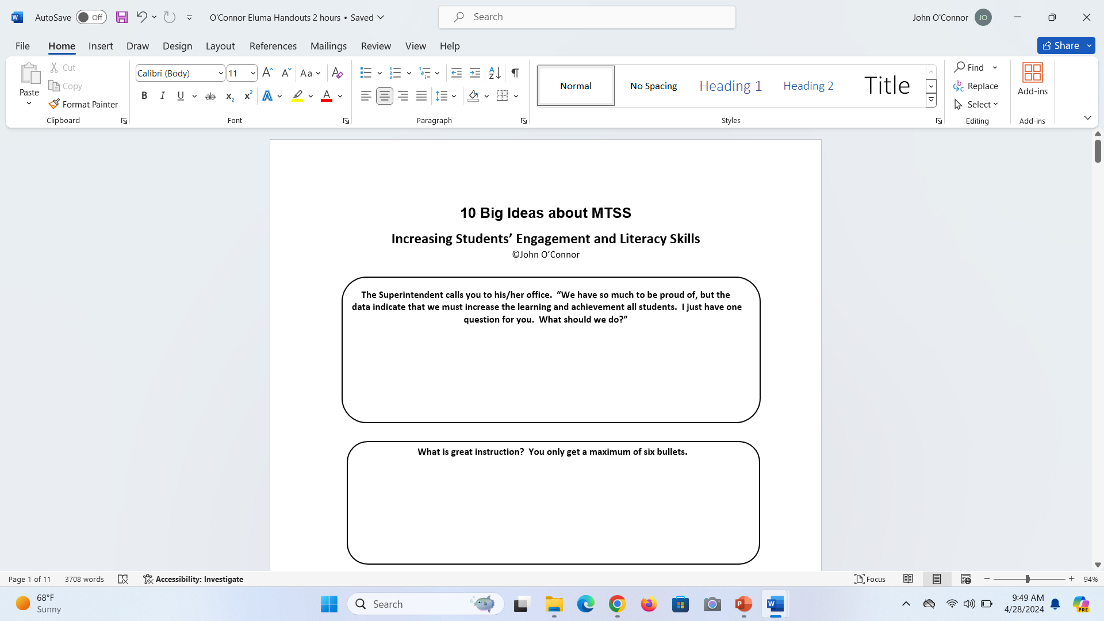
First Activity

Slide 7
Share your thoughts with your colleagues.

Slide 8
Add one more thing to your list

Slide 9
Debrief

Slide 10
At the end of the day, that is THE
question…

Slide 11
At the risk of sounding arrogant…

Slide 12
I Know the Answer

Slide 13
Provide
GREAT Instruction

Slide 14
That is the answer.
That will always be the answer.
There will never be a different answer.

Slide 15
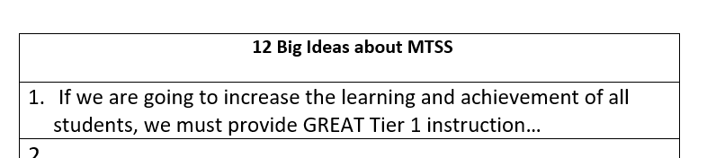

Write #1.

Slide 16
Our Objective for Today
Discuss 12 Big Ideas about MTSS

Slide 17
Back to GREAT Instruction

Slide 18

Provide GREAT Tier 1 instruction in every class, in every school, for every student, every day.

Slide 19
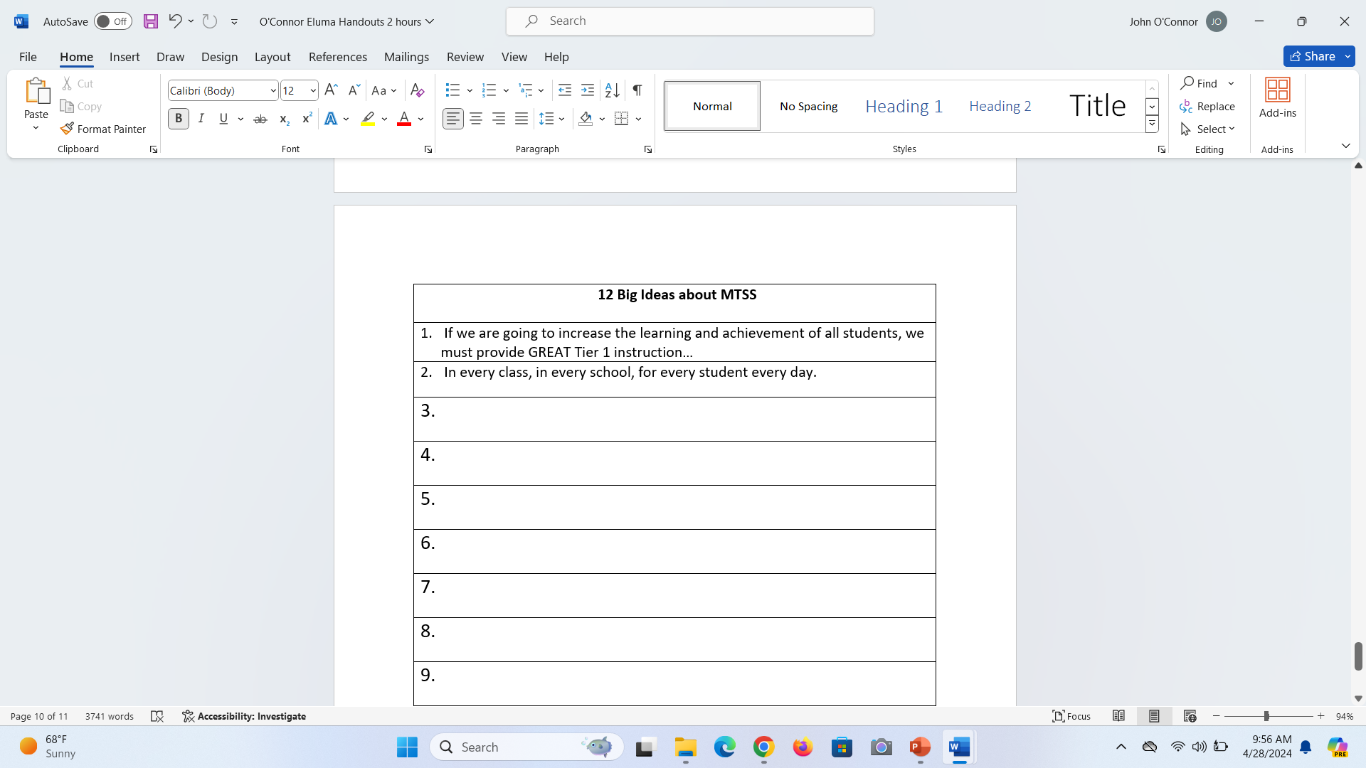
Write #2

Slide 20

The good news…
We, as educators, control 100% of that.

Slide 21
If GREAT instruction is the answer, what is it?

Slide 22
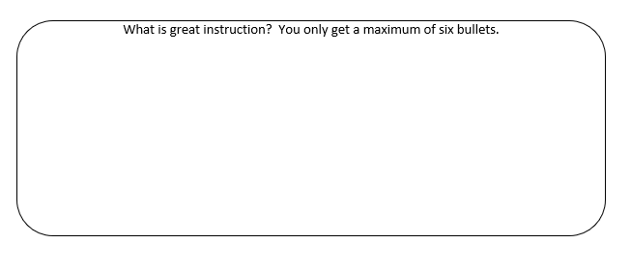

What is GREAT instruction?

Slide 23
Share with your colleagues.

Slide 24
Put a mark next to anything that was common between you.

Slide 25
Debrief

Slide 26
GREAT Instruction includes:
Standards Driven Instruction
Rigor
Ongoing assessments/student work that guides instruction (i.e., benchmarking, progress monitoring, work samples, discussions with students, students’ reading orally, etc.)
Differentiation in Flexible Grouping
Scientific or evidenced-based instructional practices
What piece is missing?

Slide 27
The missing piece
Magic

Slide 28
How do you like this acronym?
GREAT instruction is:
Guided by the performance standards
Rigorous with research-based practices (two parts)
Engaging and exciting
Assessed continuously to guide instruction
Tailored (differentiated) in flexible groups

Slide 29
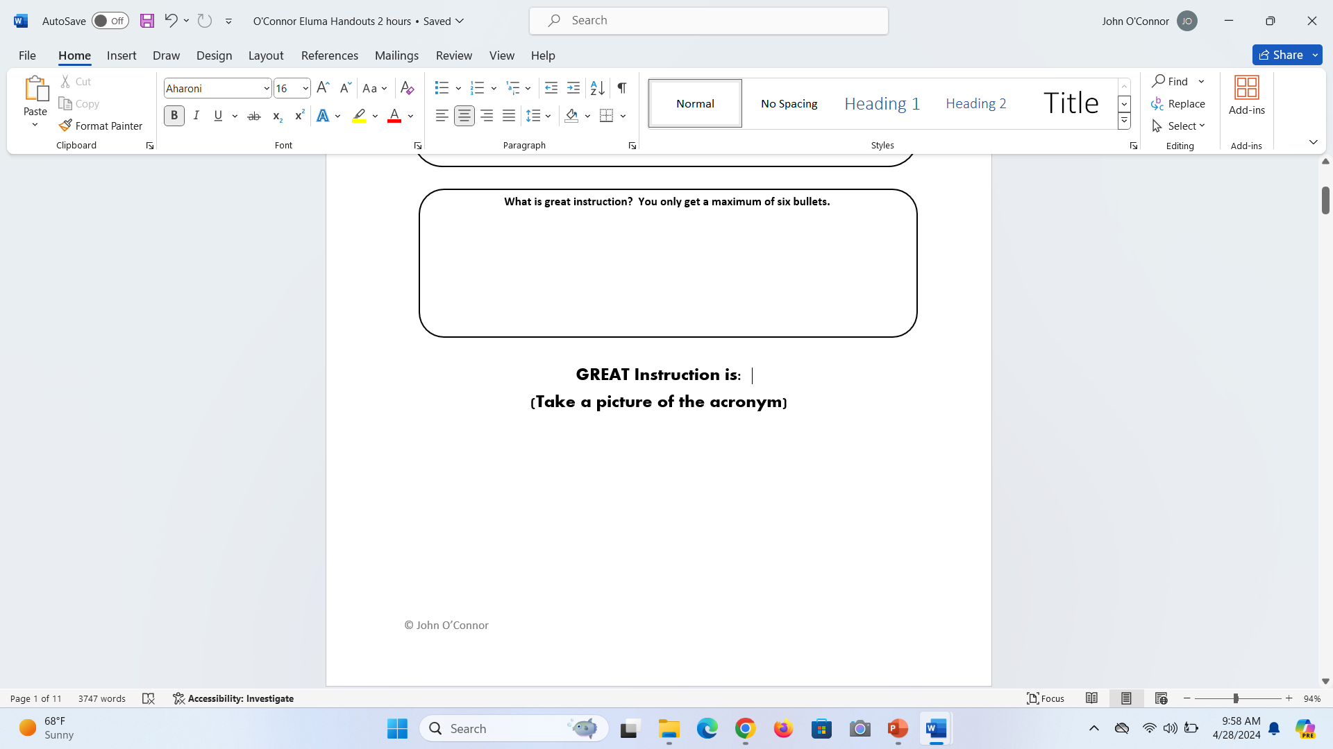

Slide 30

Note
GREAT Instruction also applies to non-academic instruction
  Behavior
  Social/Emotional
  Communication
  Self-Advocacy
  Student Agency
  Collaboration
  Etc.

Slide 31
Important Message!!!
Teachers are critically important.
  Ultimately providing instruction for our students
  Biggest impact on those students
They are not completely responsible.
As administrators (and others outside of the classroom), we have the obligation to create the environment and context where teachers can successfully provide GREAT instruction.

Slide 32
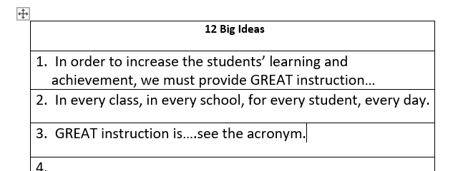
Write #3

Slide 33
What’s so special about
“GREAT Instruction?”
Average Instruction
Weak
Instruction
Great
Instruction
Gauge of Instruction

Slide 34
Our students who struggle… are more susceptible to average or weak instruction than other students.
If any of those elements are not hitting at full force, students who struggle will underperform.

Slide 35

The GREAT instruction acronym is the 1,000 ft view.

Slide 36
Let’s pretend you have 100 staff members in a school and you lined them up…

Slide 37
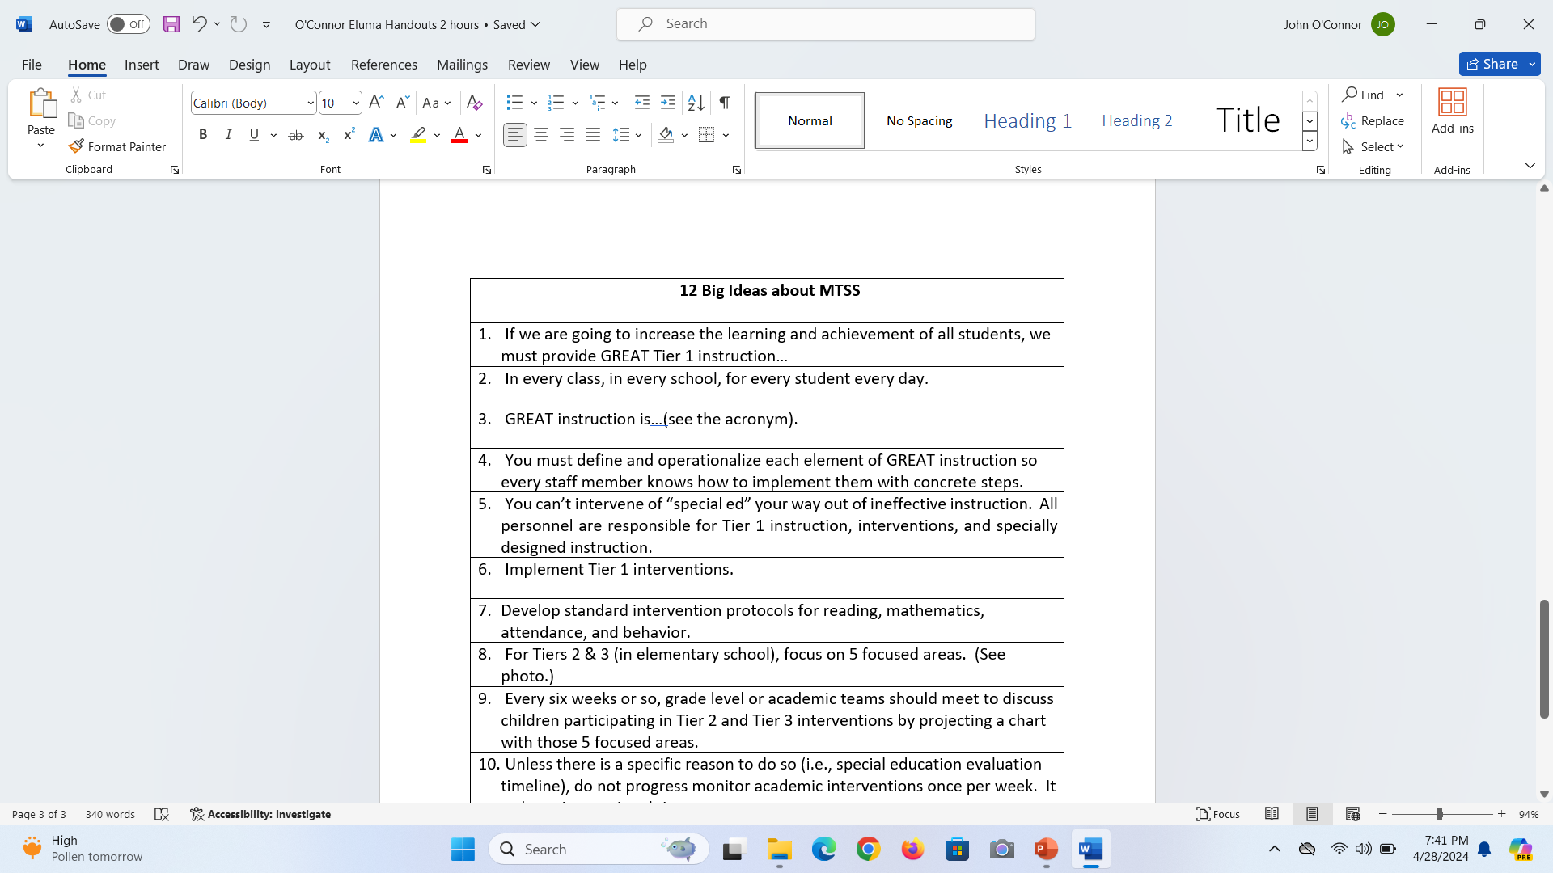
Write #4

Slide 38
Today, we are discussing MTSS.
Why haven’t I discussed interventions yet?

Slide 39
You cannot intervene or “special ed” your way out of ineffective Tier 1 instruction.

Slide 40
Who’s job is Tier 1 instruction?
General education personnel or special education personnel?

Slide 41
Who’s job is specially designed instruction?
General education personnel or special education personnel?

Slide 42
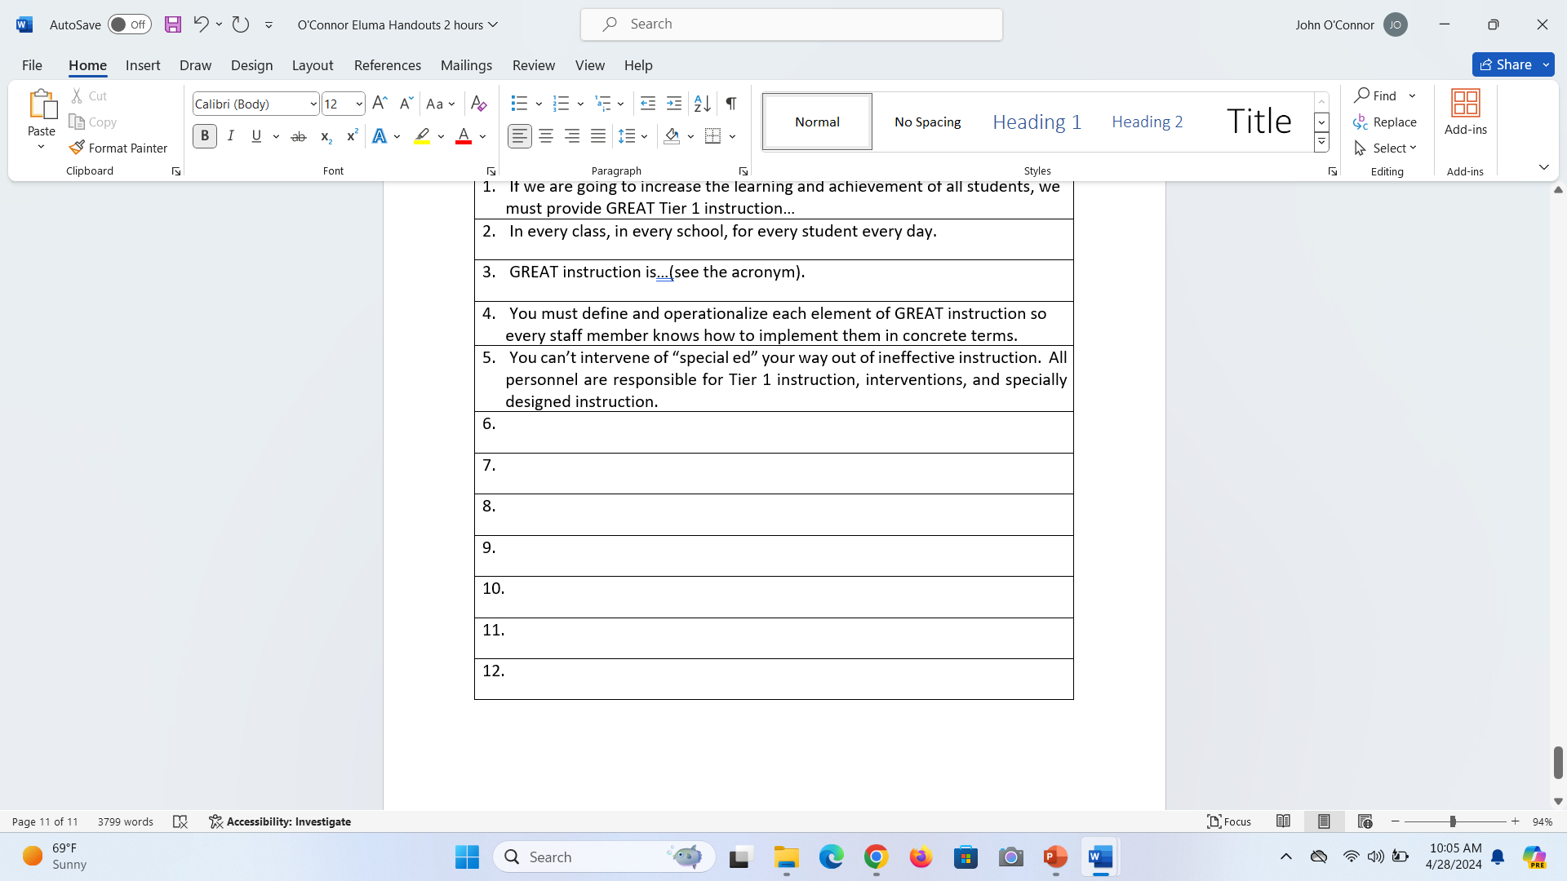
Write #5

Slide 43
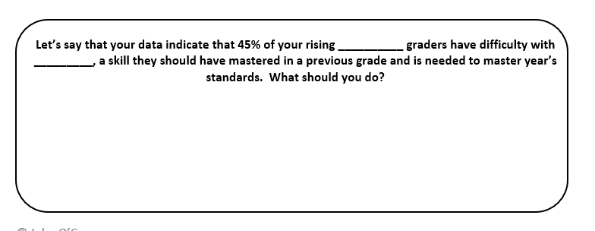
Work by yourself.

Slide 44
Let’s get up and move around

Slide 45
Add one more idea to your response.

Slide 46
Debrief

Slide 47
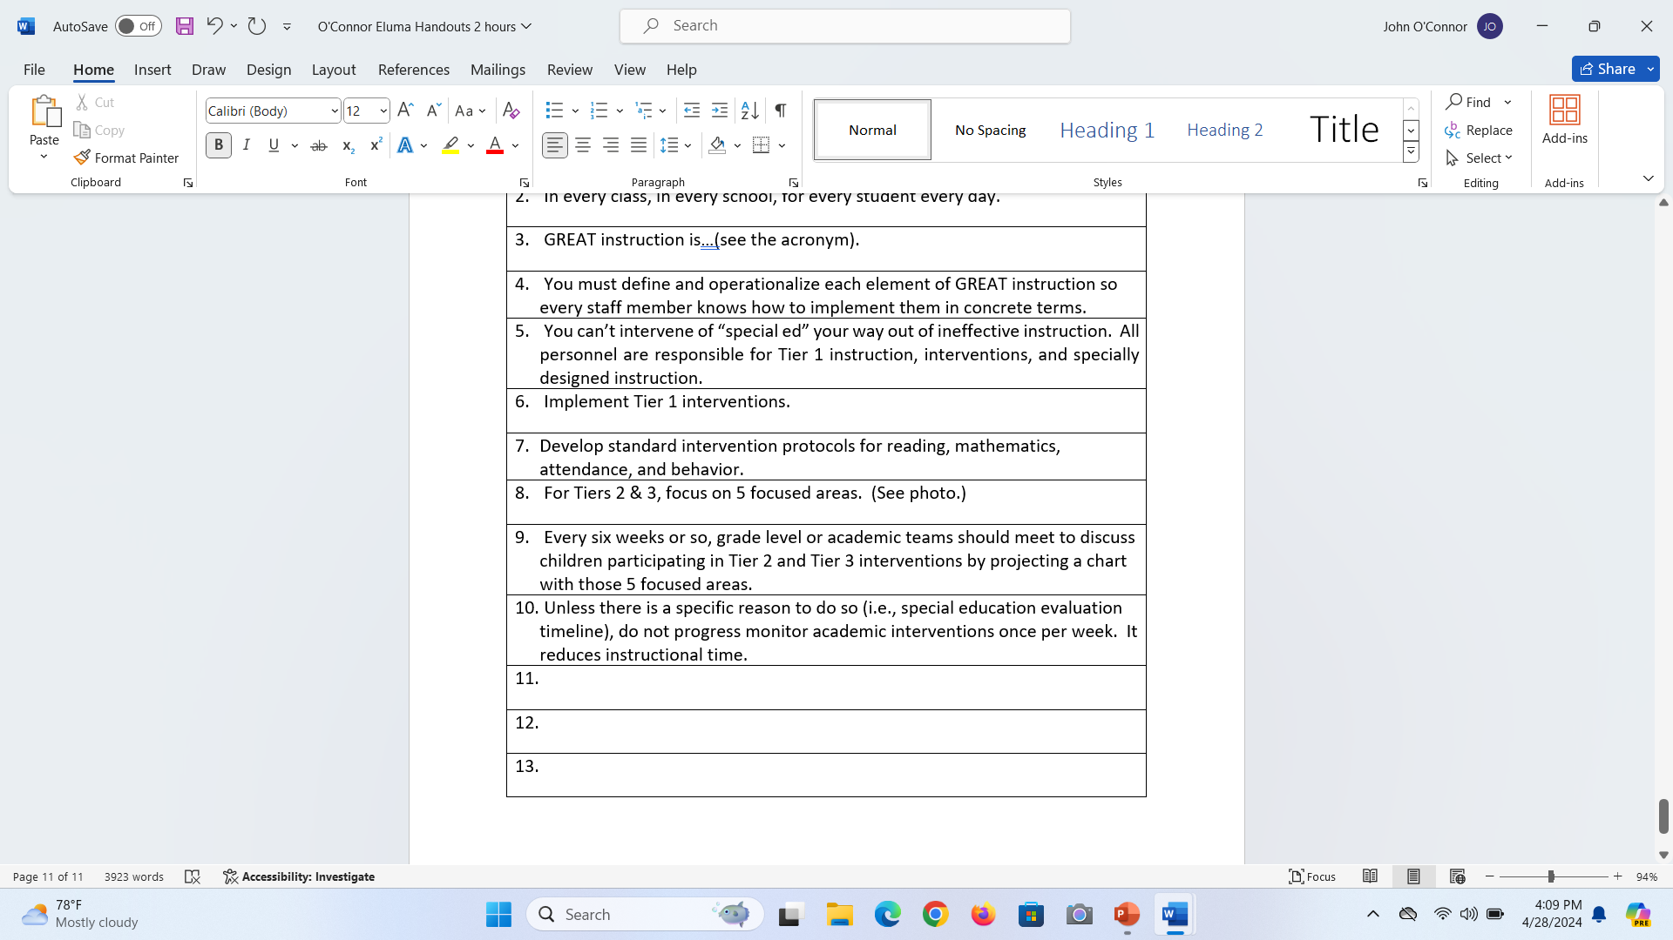
Write #6

Slide 48
Let’s turn our attention to
Tiers 2 & 3.

Slide 49
What do you think about this scenario?

Slide 50
Scenario
You take your personal child to the dentist. After the exam, the dentist speaks with you. “Your son/daughter was great. He/she has a cavity. We are going to have a meeting to discuss what to do. I am going to bring some ideas and the dental hygienists will bring their thoughts. We might even get some ideas from the internet. We also want you to bring your thoughts.”
What do you think about this scenario?

Slide 51
Debrief

Slide 52
Does it sound like how tiered interventions are implemented in your school?
Too many meetings
Too much discussion
Too much paperwork
Very little impact on student learning

Slide 53
Going to make T-Shirts
Let’s do less, better

Slide 54
Just in case…
If you are having individual meetings with parents in Tier 2 – STOP it!

Slide 55
Historically, there are two approaches to MTSS
Standard Intervention Approach
Problem-Solving Approach
You need Standard Intervention Protocols layered with a problem-solving approach

Slide 56
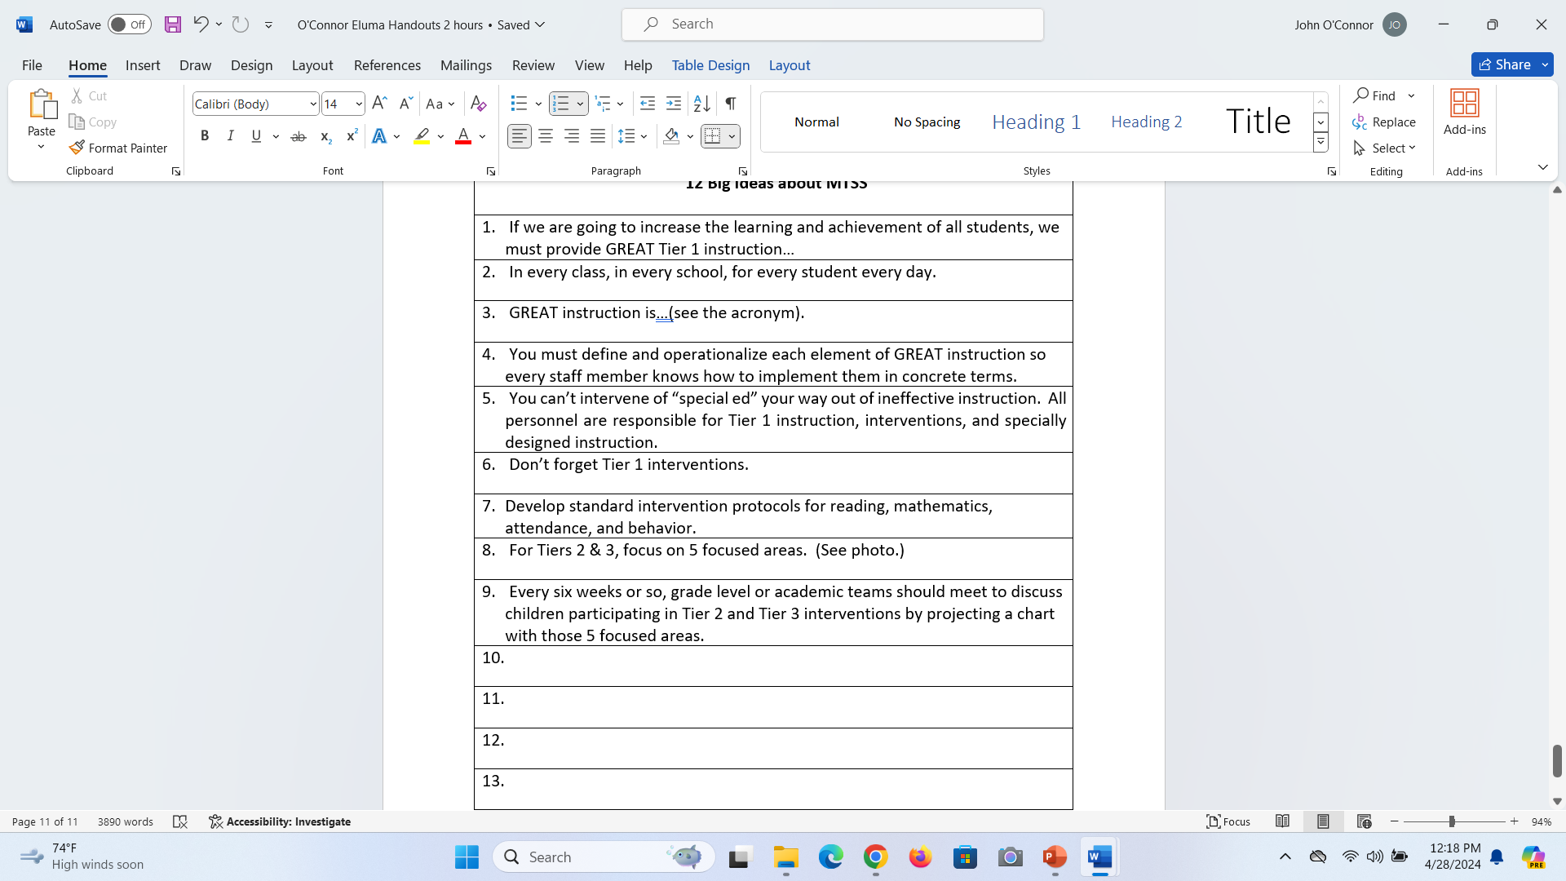
Write #7

Slide 57
For Tiers 2 & 3…
We should focus on five components
  Specific Area of Weakness
  Why?
  Research-based Intervention (or evidenced-based)
  Validated Progress Monitoring Tool
  Ongoing Analysis of Data
Take a picture of this list.

Slide 58
Have teacher grade-level meetings about every 6 weeks (with a well-trained administrator facilitating) to discuss students who are participating in interventions – both Tier 2 and Tier 3.

Slide 59
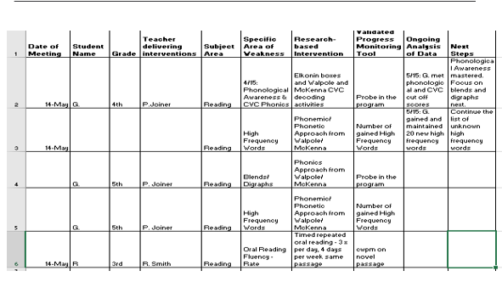

Slide 60
Table Discussion
Could focusing on the five big components of interventions simplify and focus your Tier 2 and 3 interventions/discussions?
Would having grade-level meetings about every 6 weeks (with a well-trained administrator facilitating) to discuss students in Tiers 2 or 3 provide good professional development, brainstorming, support, and monitoring?

Slide 61

Write #8 & 9

Slide 62
Important Note
You still must have individual meetings with parents for students participating in Tier 3/SST interventions
You must follow the SST Rule re:
  Participants
  What is discussed
  What is documented

Slide 63
Let’s talk about progress monitoring
How often should you progress monitor?
Behavior and attendance are assessed every day.
Academic areas should not be progress monitored weekly. That reduces instructional time.
Exception: If the Special Education Department tells you there aren’t enough data points, then probe as often as they recommend.

Slide 64
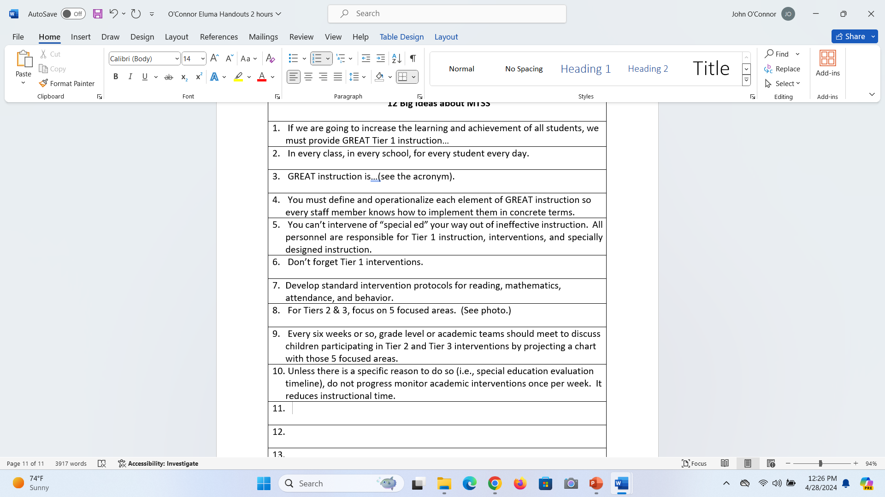
Write #10

Slide 65
In Georgia, we have two literacy laws
Georgia Early Literacy Act
Dyslexia legislation
Now is the time to change your MTSS processes to align with those laws!!!
Don’t have MTSS and separate processes for the requirements of the laws.

Slide 66
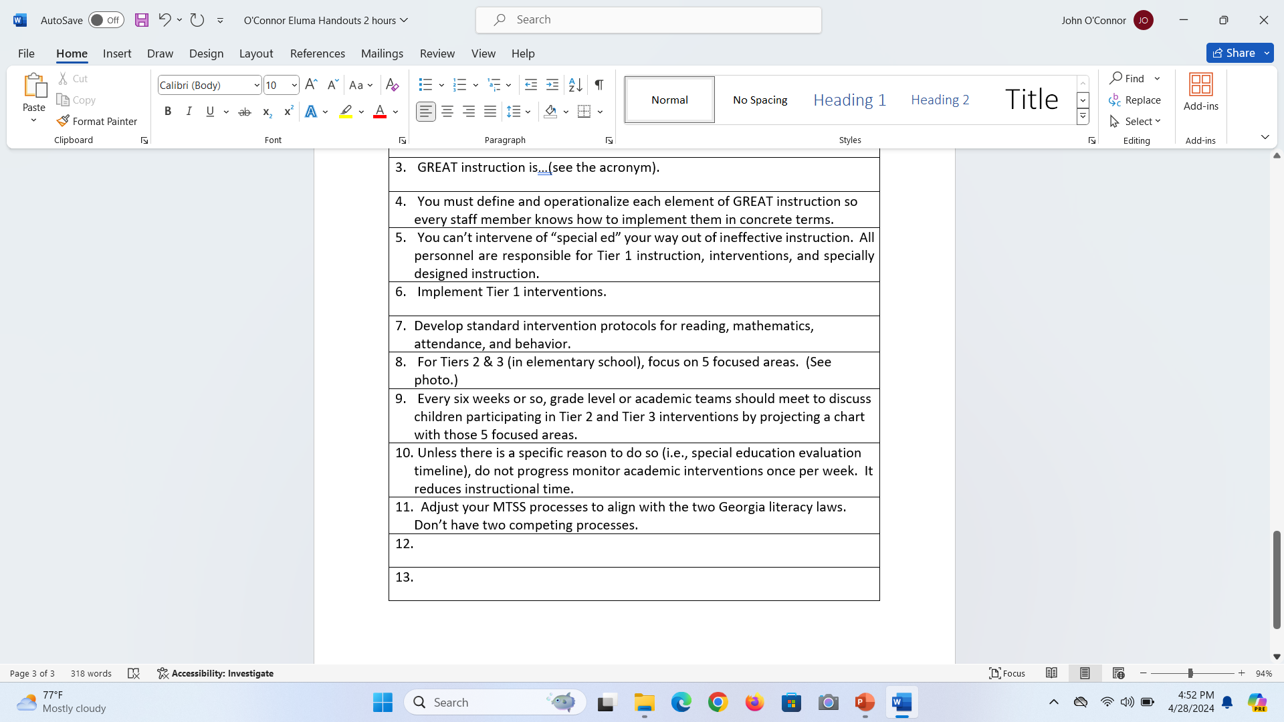
Write #11

Slide 67
Let’s discuss “walk to” interventions in elementary schools

Slide 68
In middle and high school, tiered interventions are drastically different.

Slide 69
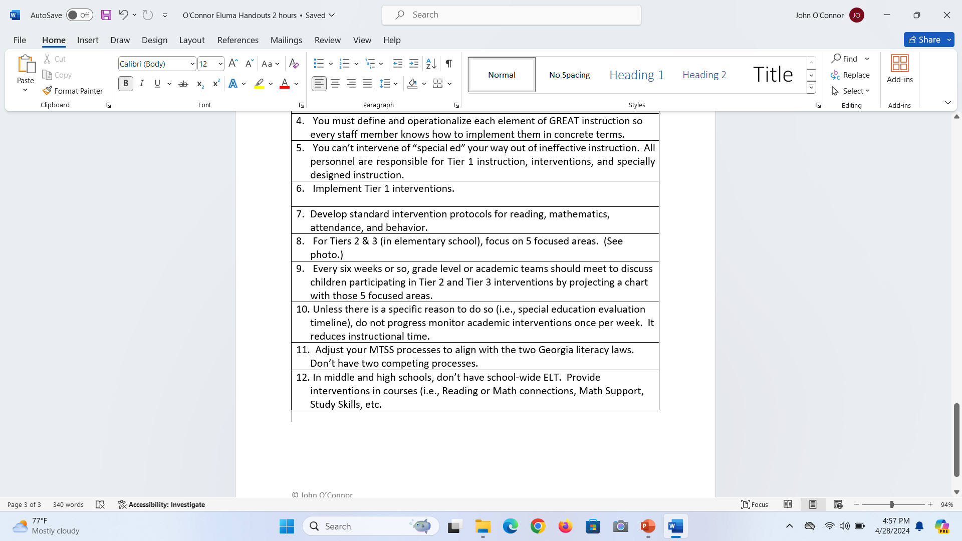
Write #12

Slide 70
Thank You!!!
Thank You!!!
Thank You!!!

